Slide 1
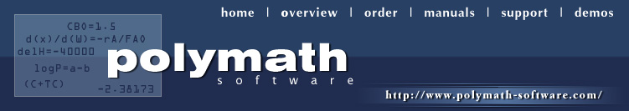
Application of Numerical Problem Solving in Chemical Engineering Coursework
Presenters: Robert P. Hesketh, Rowan University; Michael B. Cutlip, University of Connecticut

Slide 2
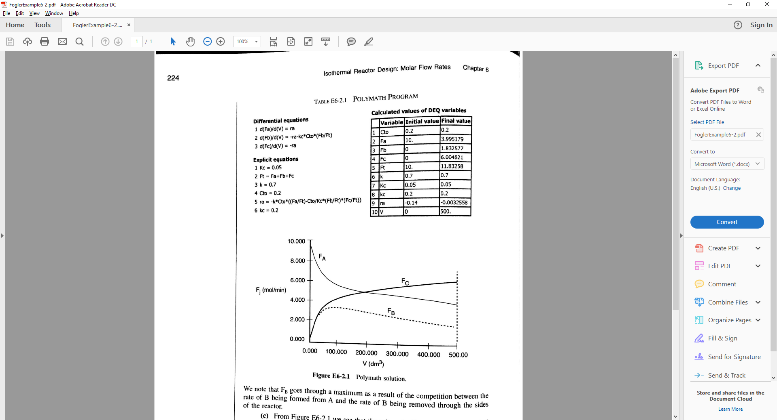
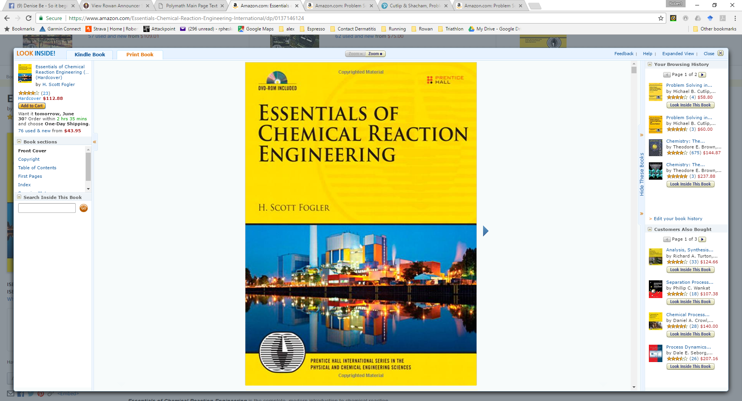
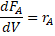
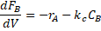
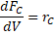
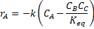
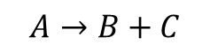
Integration of POLYMATH with Fogler’s chemical reaction engineering textbook
$$A→B+C$$
Example 6-2 Membrane Reactor
Integration already accomplished! No extra work required.

Slide 3
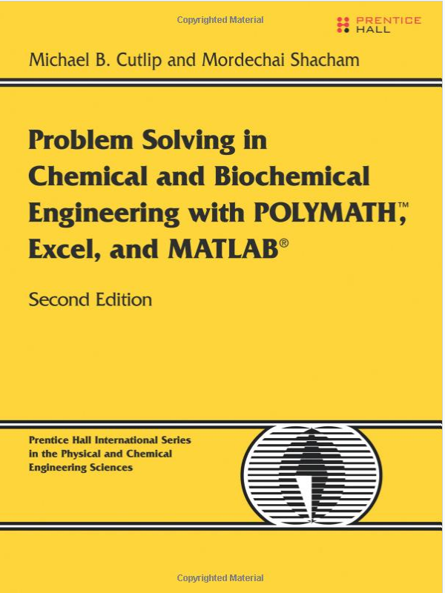
How do you integrate POLYMATH into your course?
Start with examples from POLYMATH Text
Thermodynamics,
Fluid Mechanics,
Heat Transfer,
Mass Transfer,
Chemical Reaction Engineering,
Phase Equilibria and Distillation,
Process Dynamics and Control,
Biochemical Engineering

Slide 4
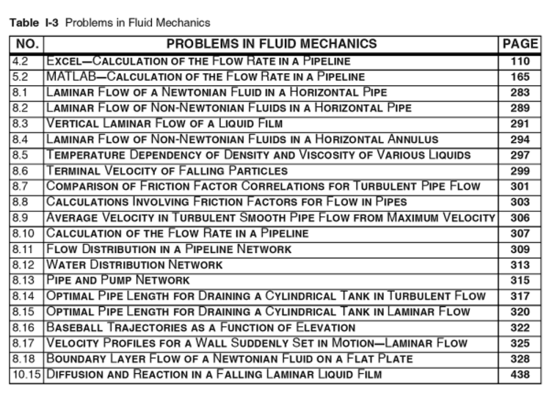
Polymath Text: Fluids Course
21 Problems in fluids

Slide 5
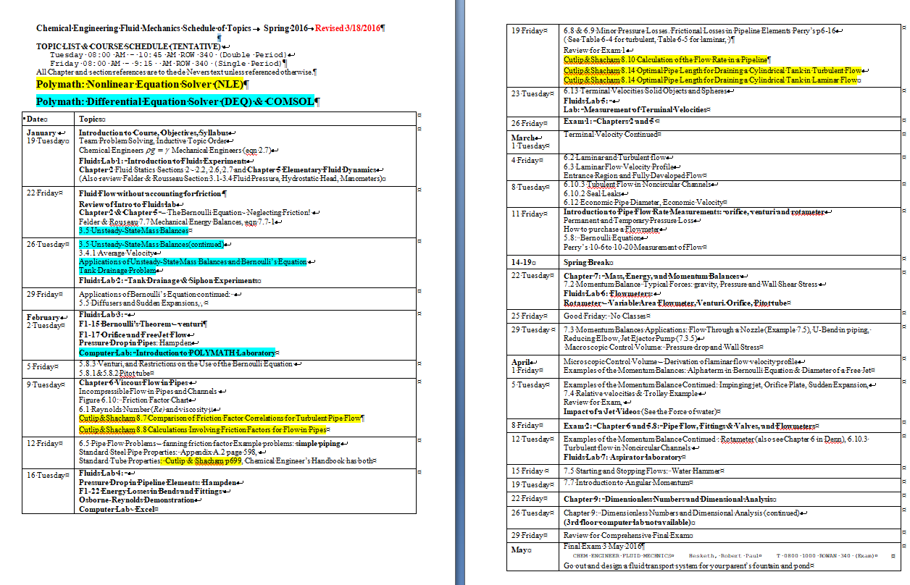
Example Schedule of Topics for ChE Fluids (2 credit hour)
Polymath: Nonlinear Equation Solver (NLE)
Polymath: Differential Equation Solver (DEQ) & COMSOL

Slide 6
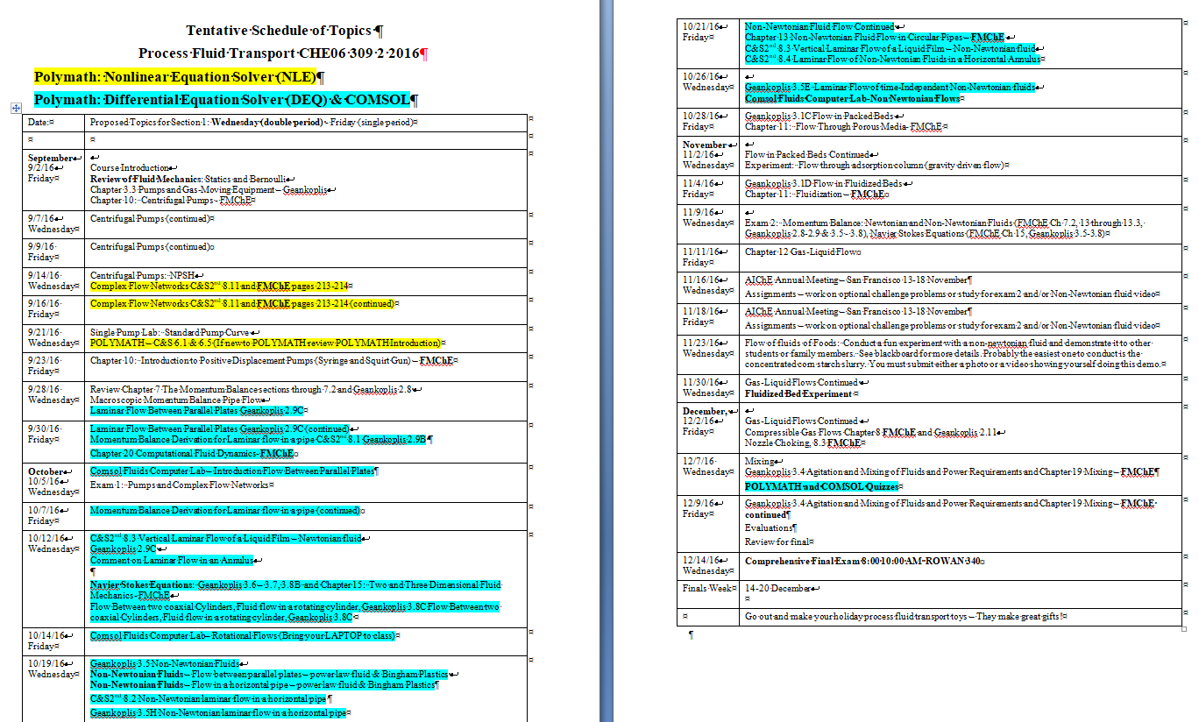
Adv. ChE Fluids (2 cr)

Slide 7
Typical Fluids Problems

Slide 8
POLYMATH in a classroom
Students need to understand the models that they use.
Have students derive the model equations
Then enter them into POLYMATH
POLYMATH is not a “canned” program in which the equations are hidden such as in COMSOL and ASPEN
The next slides give an example of using POLYMATH with a problem in Fluids

Slide 9
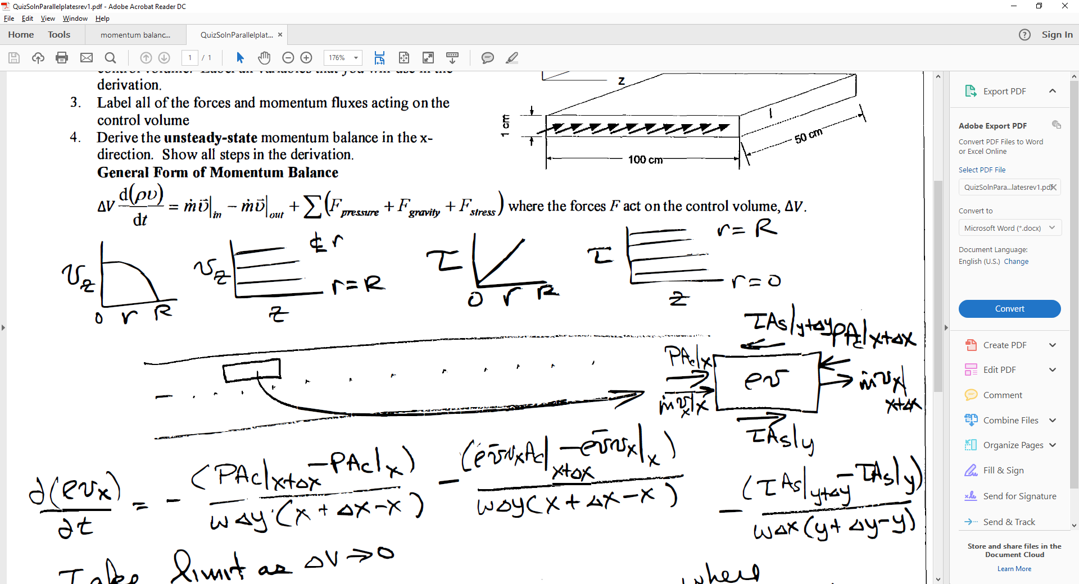
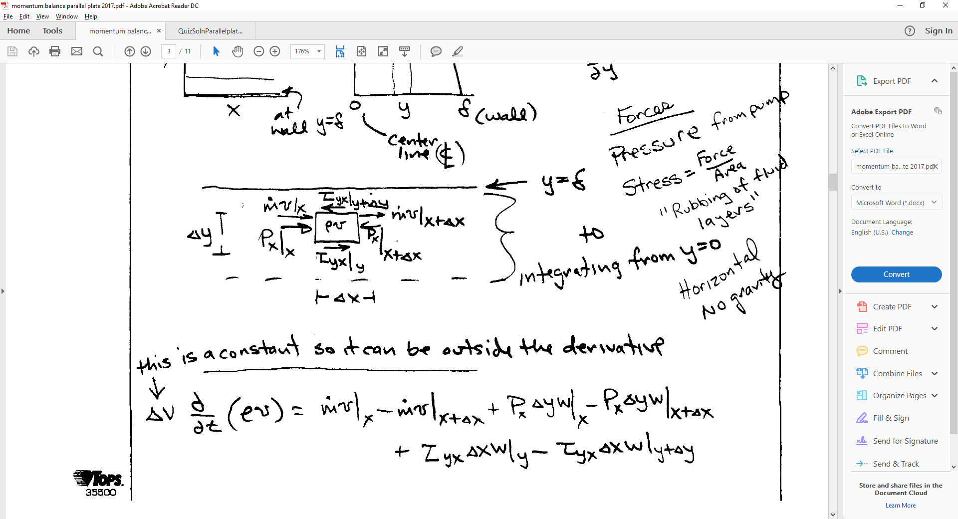
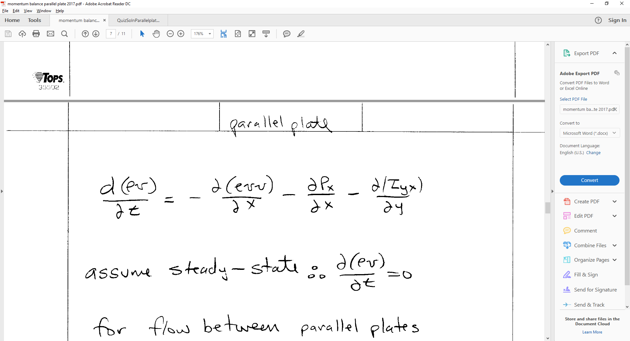
Newtonian Fluid Flow Between Parallel Plates Example
Figures showing flow
Graphs with expected behavior
Control Volume – shell balance
Derivation
Simplifications: steady-state etc.
y
y
0
0

Slide 10
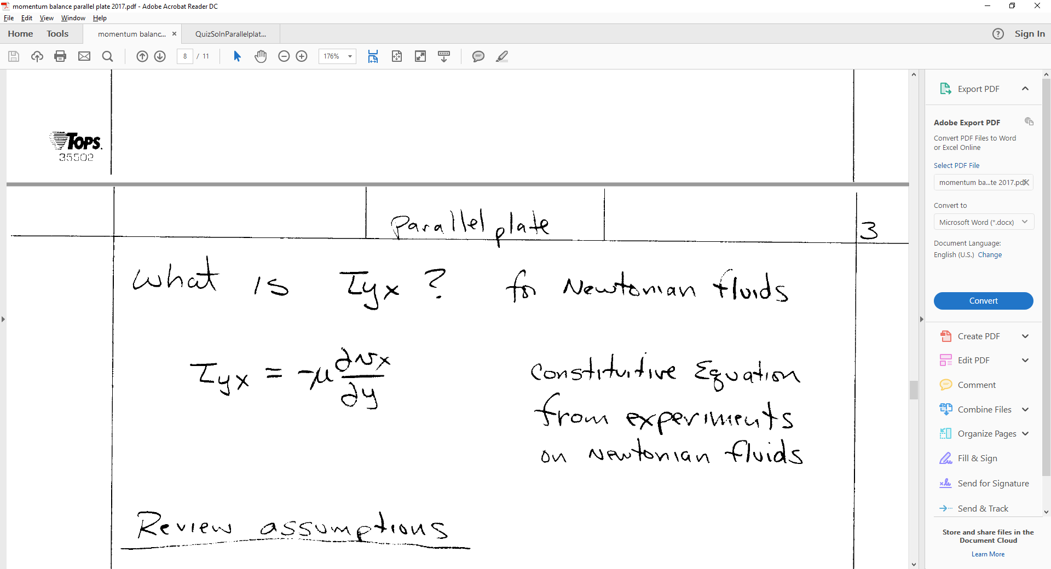
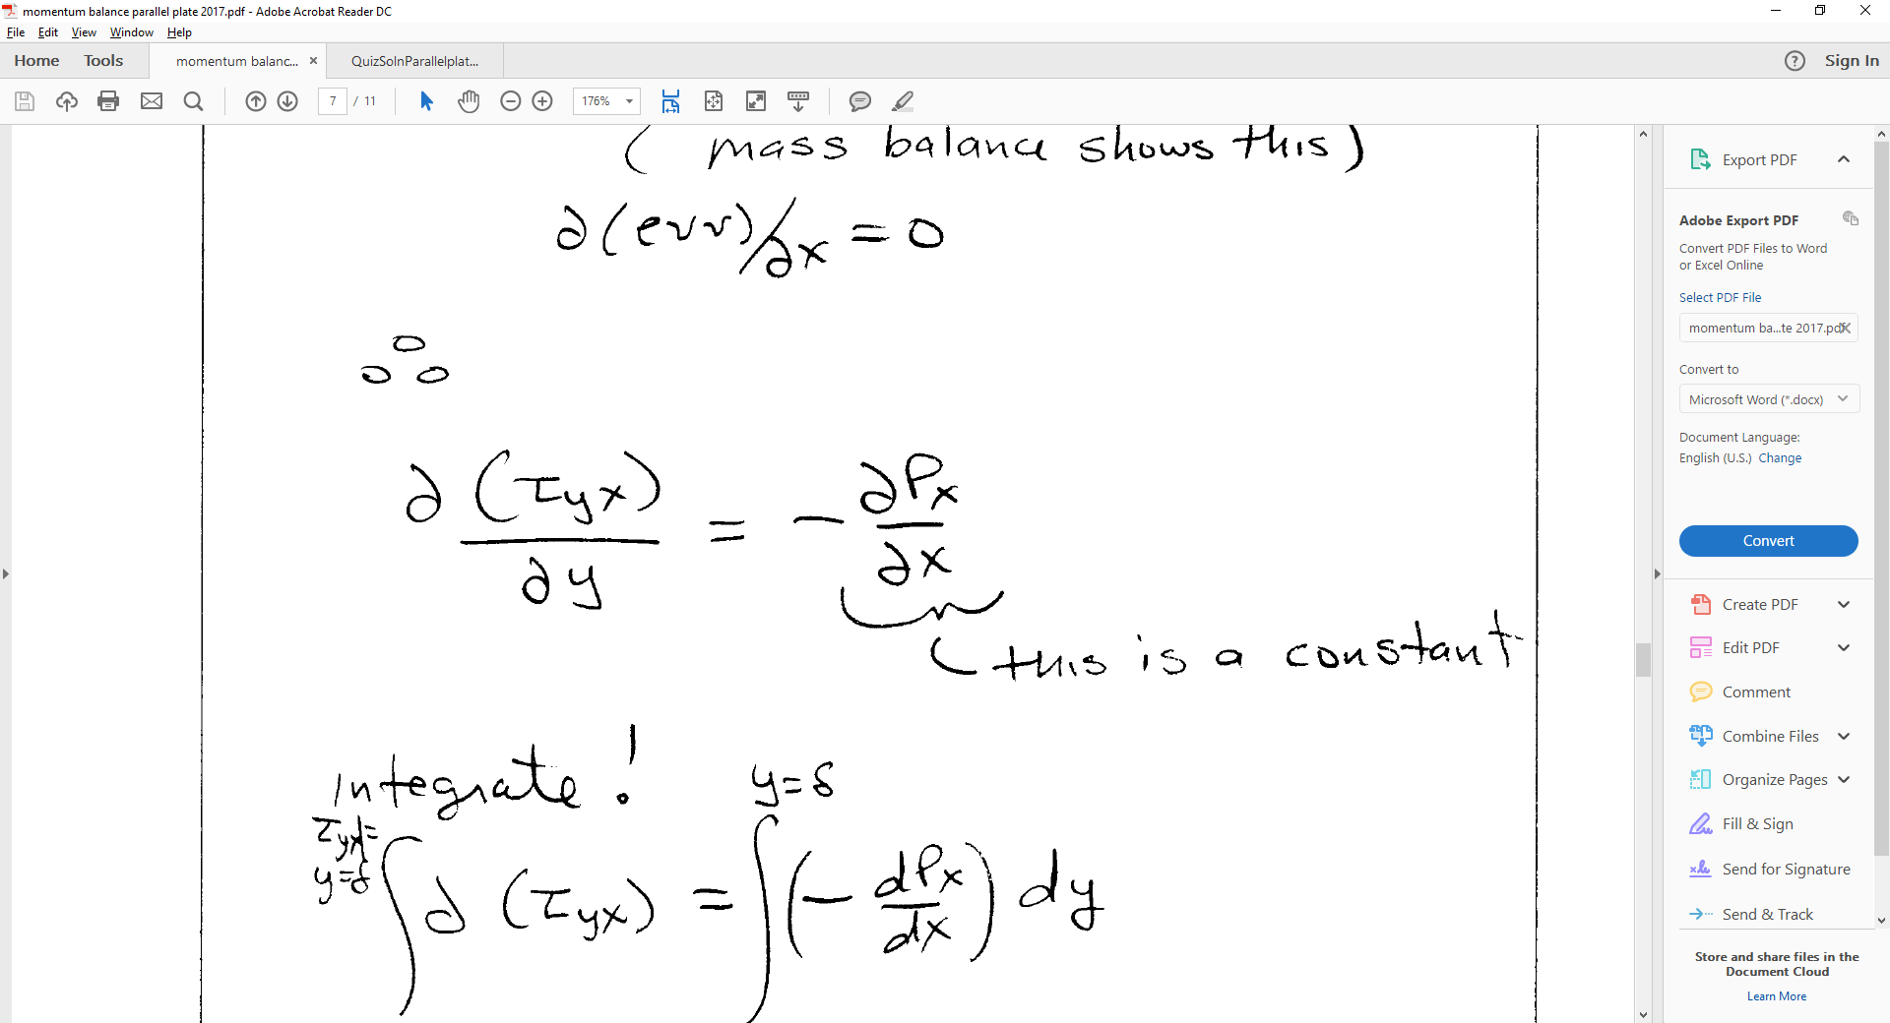
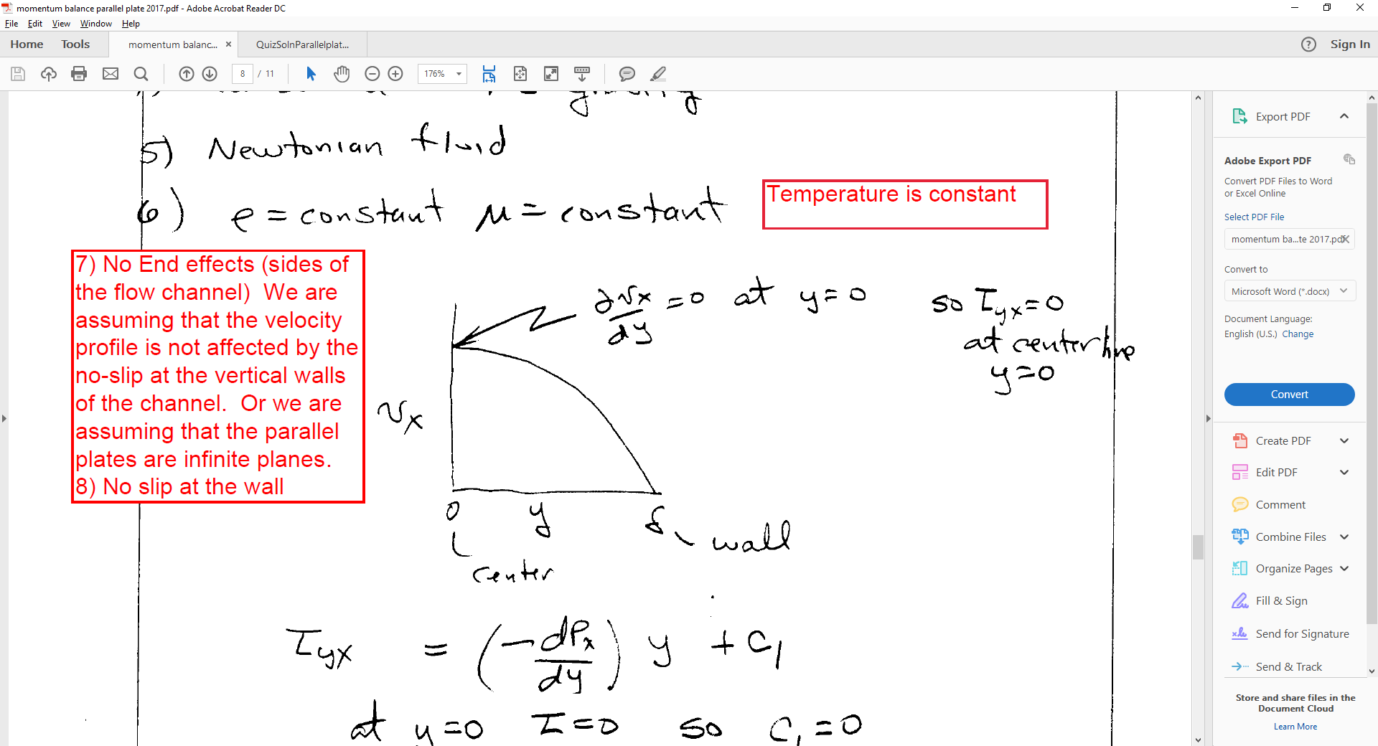
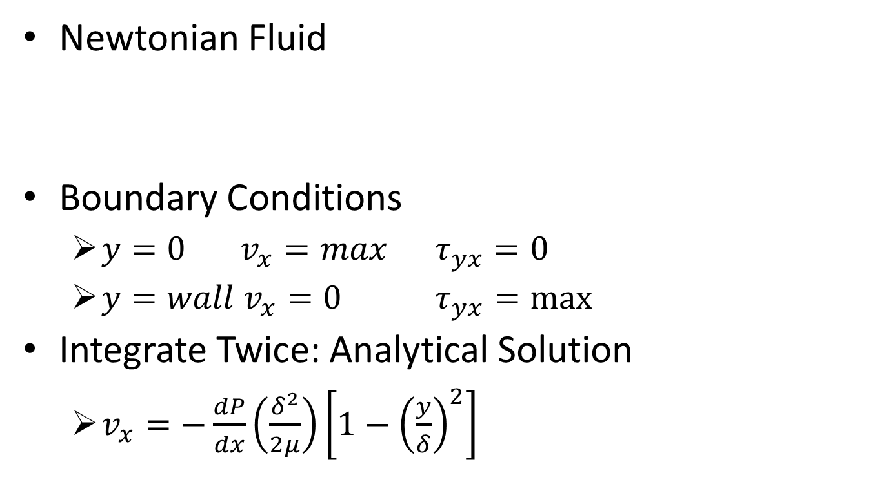
Analytical Solution
Newtonian Fluid
Boundary Conditions
$y=0 { v}_{x}=max { τ}_{yx}=0$
$y=wall v_{x}=0 { τ}_{yx}=max$
Integrate Twice: Analytical Solution
$v_{x}=−\frac{dP}{dx}\left(\frac{δ^{2}}{2μ}\right)\left[1−{\left(\frac{y}{δ}\right)}^{2}\right]$

Slide 11
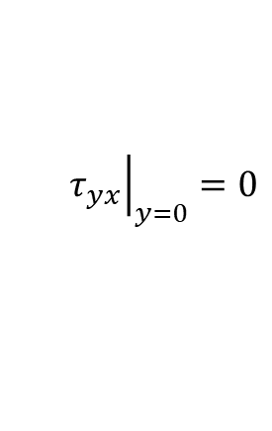
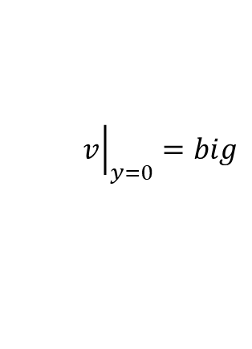
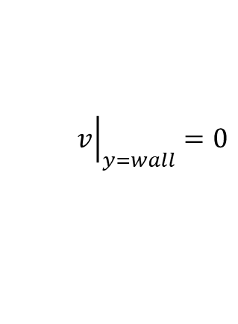
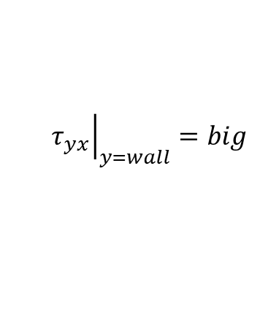
Numerical Solution
Newtonian Fluid
Two coupled ODE’s and Split Boundary Condition
Then manipulate two ODE’s so they can be solved using the POLYMATH Differential Equation Solver (DEQ)
$${\left.v\right|}_{y=0}=big$$
$${\left.τ_{yx}\right|}_{y=0}=0$$
$${\left.v\right|}_{y=wall}=0$$
$${\left.τ_{yx}\right|}_{y=wall}=big$$

Slide 12
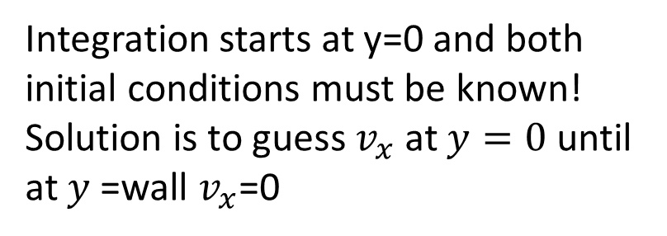
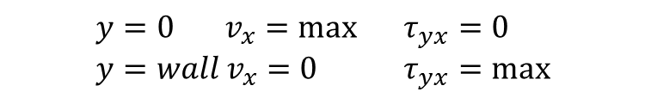
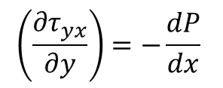
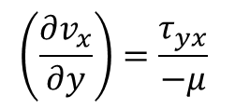
Required manipulation to solve 2 ODE’s with split Boundary conditions
$$\left(\frac{∂v_{x}}{∂y}\right)=\frac{τ_{yx}}{−μ}$$
$$\left(\frac{∂τ_{yx}}{∂y}\right)=−\frac{dP}{dx}$$
$$y=0 { v}_{x}=\max{} τ_{yx}=0 \\ y=wall v_{x}=0 { τ}_{yx}=max$$
Integration starts at y=0 and both initial conditions must be known!
Solution is to guess $v_{x}$ at $y=0$ until at $y$=wall $v_{x}$=0

Slide 13
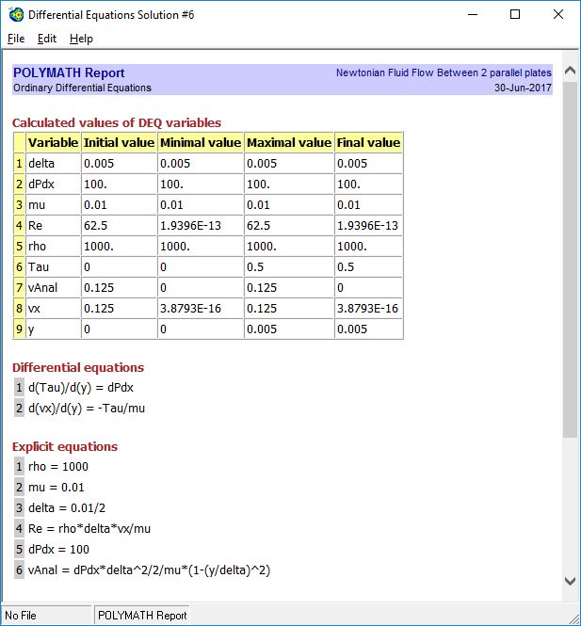
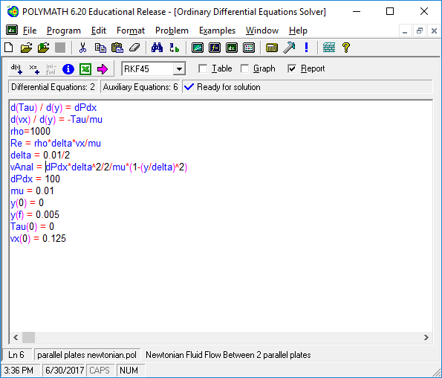
Solution
Trials using interpolation after 3rd guess

Slide 14
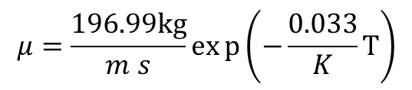
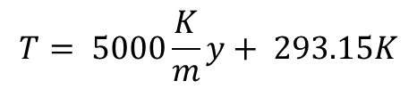
Students are Confused
Question Why do I have to do trial & error for the initial velocity? Why not just plug-in the maximum velocity from the analytical solution?
Answer Your goal is always to compare a numerical solution to a simple analytical problem solution. This shows that the numerical solution method is correct.
Then give students a more complex problem with one of the plates heated resulting in a temperature profile in the liquid. Now they must do the trial and error procedure.
Temperature Profile in liquid:
$$T= 5000\frac{K}{m}y+ 293.15K$$
$$μ=\frac{196.99kg}{m s}exp\left(−\frac{0.033}{K}T\right)$$

Slide 15
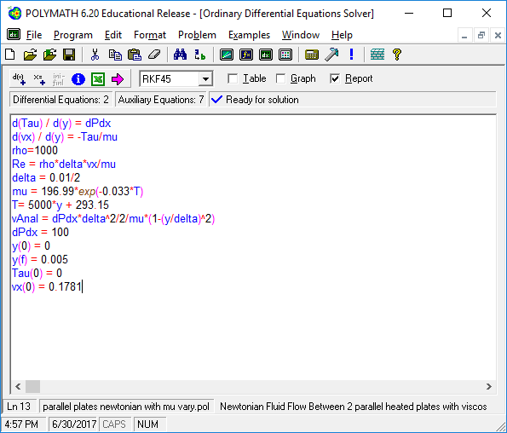
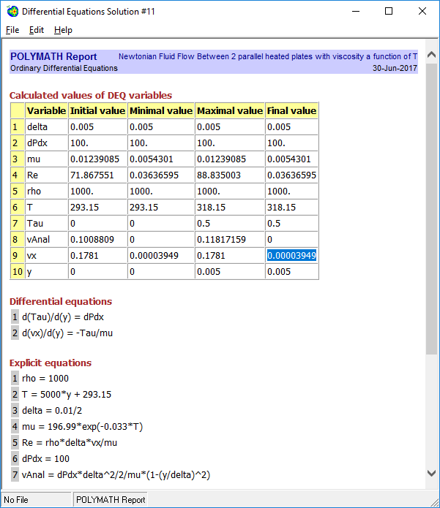
Heated Plates
Trials using interpolation after 3rd guess
v at center v at wall
0.125 -0.05306
0.12 -0.05806
0.180 0.001939
0.17806 3.95E-05

Slide 16
What about models that are formulated as integrals?
Previous state of the art numerical methods where based on evaluating integrals
Trapezoidal rule
Simpson’s Rule
Many textbooks present models only as integrals

Slide 17
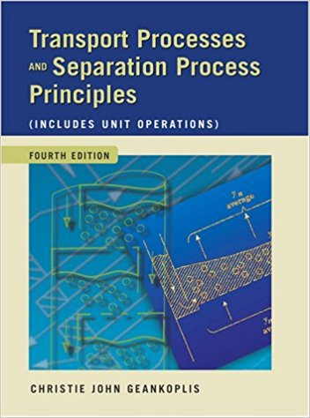
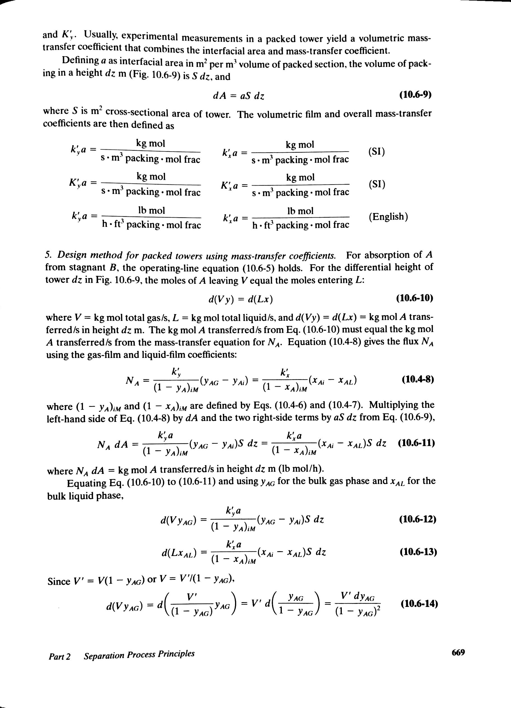
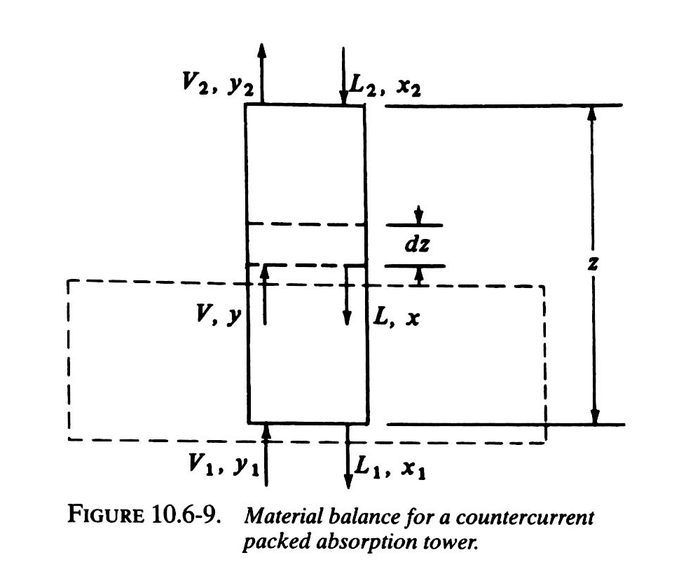
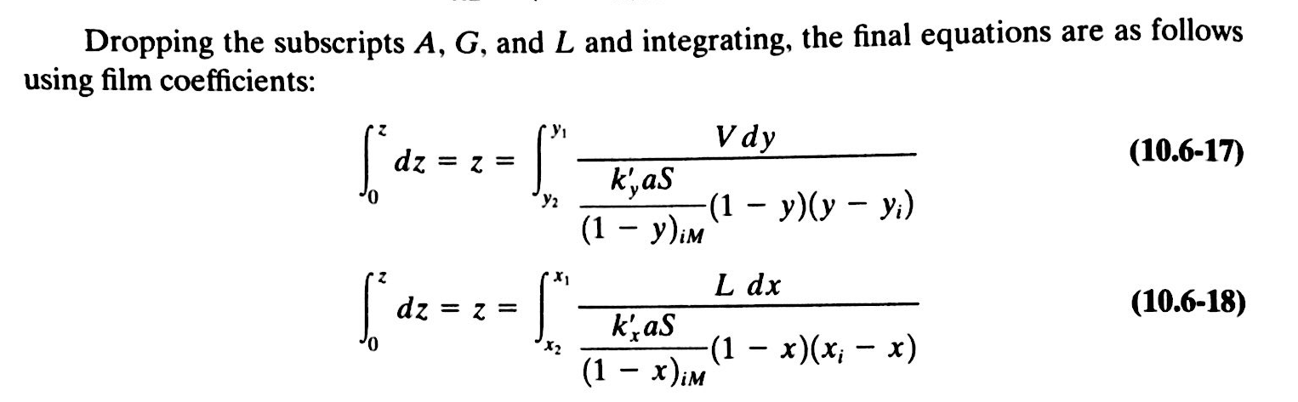
Packed Towers: Gas Absorption Traditional Approach using integrals

Slide 18
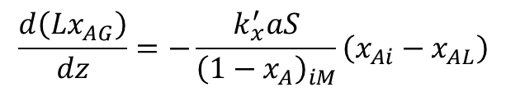
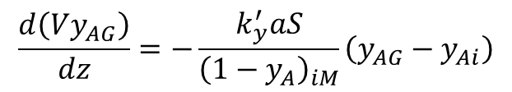
Derive model using Plug Flow Assumption: Create Differential Equations
$$\frac{d\left(Vy_{AG}\right)}{dz}=−\frac{k_{y}^{′}aS}{{\left(1−y_{A}\right)}_{iM}}\left(y_{AG}−y_{Ai}\right)$$
$$\frac{d\left(Lx_{AG}\right)}{dz}=−\frac{k_{x}^{′}aS}{{\left(1−x_{A}\right)}_{iM}}\left(x_{Ai}−x_{AL}\right)$$

Slide 19
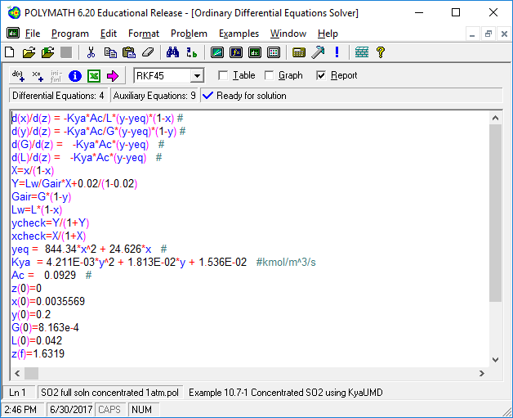
Polymath Absorber Model

